Slide 1
Printer Management
Version A.01
H3064S Module 16 Slides

Slide 2
Overview of the Spooling System
Users’ Print Requests
C
H
X
K
A
Z
D
B
K
P
lpadmin
Accept
Reject
(Open)
(Closed)
prtrA
lpmove
Printer
laser
Class
cancel
Disable
laser1
laser2
Disable
(Closed)
(Closed)
Enable
(Open)
bit
bucket
Dot Matrix Printer
Laser Printer
Laser Printer
a66973

Slide 3
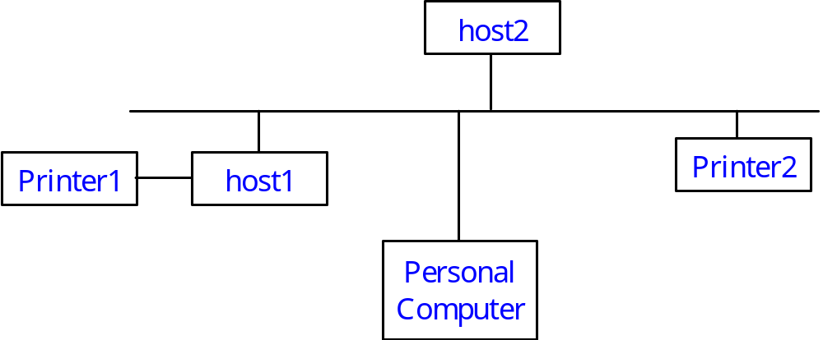
Types of Printers
Local
Remote
Network
a538103

Slide 4
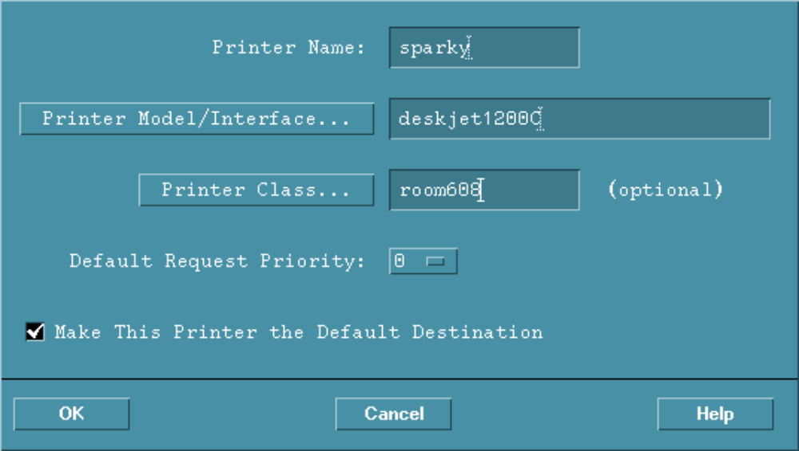
Adding Local Printers Using SAM
a538104

Slide 5
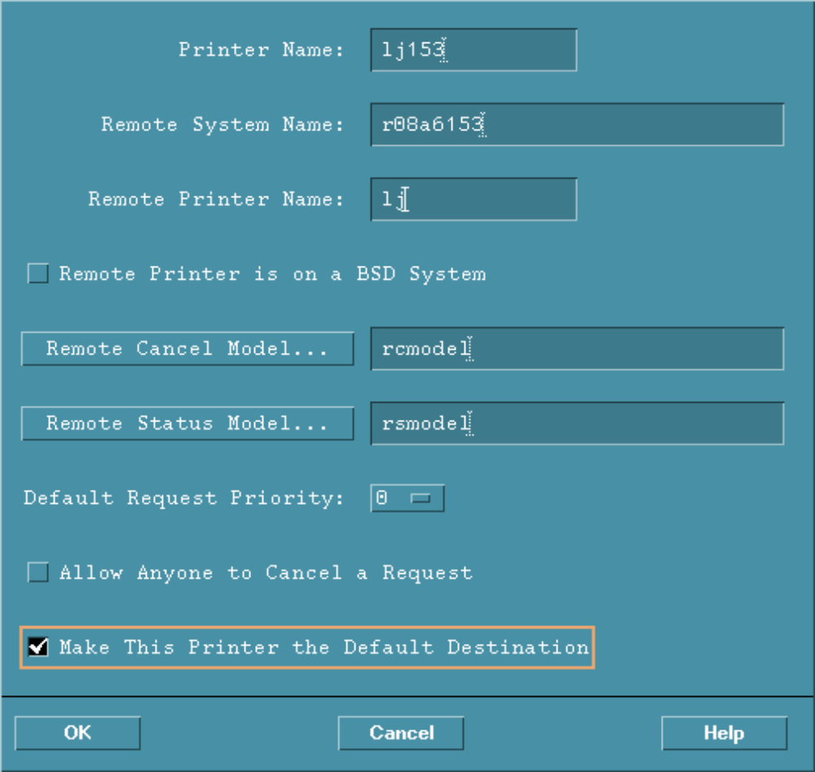
Adding a Remote Printer Using SAM
a66974

Slide 6
Adding a Network-based Printer
*****************************************
* CONFIGURATION *
* HP JetAdmin Utility for Unix *
*****************************************
Printer Network Interface
1) Create printer configuration in BOOT/TFTP
database
2) Remove printer configuration from BOOT/TFTP
Spooler:
3) Add printer to local spooler
4) Delete printer from local spooler
5) Modify existing spooler queue(s)
?) Help q) Quit
a66975

Slide 7
Directory Overview
/
etc
enable
usr
lib
lp
var
disable
bin
lpmove
model
lp
lpshut
spool
lpalt
lpstat
sbin
class
interface
member
lp
cancel
lpsched
lpfence
FIFO
accept
lp
reject
request
SCHEDLOCK
a538107

Slide 8
What Happens when a File Is Submitted with lp
$lp -dLJ filename Print request submitted
request id is LJ-#### Spooler assigns unique request ID and queues request
filename is linked or
copied to spool directory /var/spool/lp/request/LJ
Printer becomes available lpsched invokes the interface program /etc/lp/interface/LJ
File is printed
a66976

Slide 9
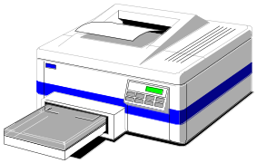
Managing Print Queues
print requests
lpmove
accept/reject
enable/disable
cancel
lj
sparky
a66977

Slide 10
Priorities and Fences
sparky
lj
5
1
0
0
queue
0
5
0
0
queue
0
a66978

Slide 11
Troubleshooting the Spooler
Potential Spooler Problems:
Spooler won't start
Scheduler won't stop
Paper jam/printer out of paper
Runaway printout
Printer won't print
a538111

